Slide 1
Data Mining and Data Science Problems
Geospatial Data Seminar

Slide 2
Overview
Data Mining
Data Collection
Preprocessing
Feature selection
Model selection
Model training
Model evaluation
Geospatial Data Mining
Ground removal
Plane fitting
Registration
Segmentation
PointNET Outlook

Slide 3
Data Collection
Gathering Data from
Databases
Sensors
APIs

Slide 4
Preprocessing
Cleaning and Preperation
Handing missing values
Normalizing data
Outliers?

Slide 5
Feature Selection
Identification of
relevant features
Important variables
Reduction of dimensionality
Imporves efficency and accuracy
High information gain features are selected
Filter-based methods
Classifier-independent
Simple and efficient
Consideration of intrinsic properties of the given data
Alternative strategies
Wrapper-based methods
Embedded methods

Slide 6
Model Selection
Different statistical models
Choose according to our problem
Examples
Hzper yapper
Lalala

Slide 7
Model Training
Data devided into training and validation set

Slide 8
Model Evaluation
F1-score
ROC-curves
Accuracy
Precision
Recall

Slide 9
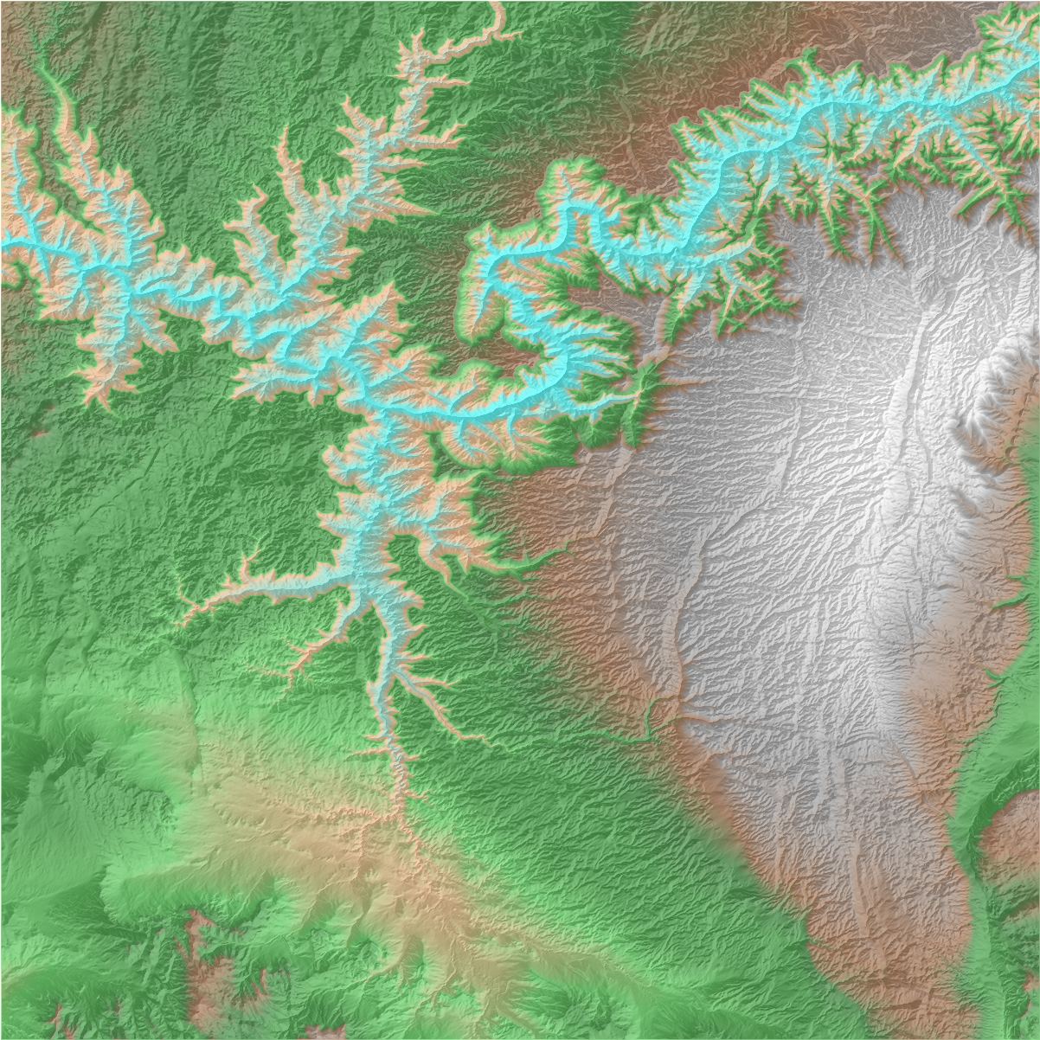
Geospatial Data analysis
How does the data mining workflow
change with geospatial data ?
https://github.com/DLR-terrabyte/eo-examples/blob/main/datasets/CopernicusDEM.ipynb

Slide 10
Ground Removal
Ground filtering
Segmenation techniques

Slide 11
Plane Fitting
Least squares fitting
Software like pcfitplane
Fitted plane is prone to be influenced by noise

Slide 12
Registration
Alignment of datasets to common cordinate system
Iterative closest point algorithm

Slide 13
Segmentation
Different segements in pcd (point cloud data)
Mutplitple homogenours regions with similar properties
Major approaches
Classify points or point clusters based on features found through feature extraction and neighborhood selection
Extract point statistics and spatial information from pointcloud
Classify using satistical and contextual modeling

Slide 14
Object Detection

Slide 15
Outlook: Point-NET
Direct processing of raw point cloud data
Doesnt require any preprocessing steps

